Slide 1
Generative AI
AI Agents

Slide 2
When user ask like this ->
Chat Bot ->
Can you tell me status of my order
Can you please provide me my leave balance
How much leave I took till June 2026 this year
Can you please review my code which checked in today -MCP

Slide 3
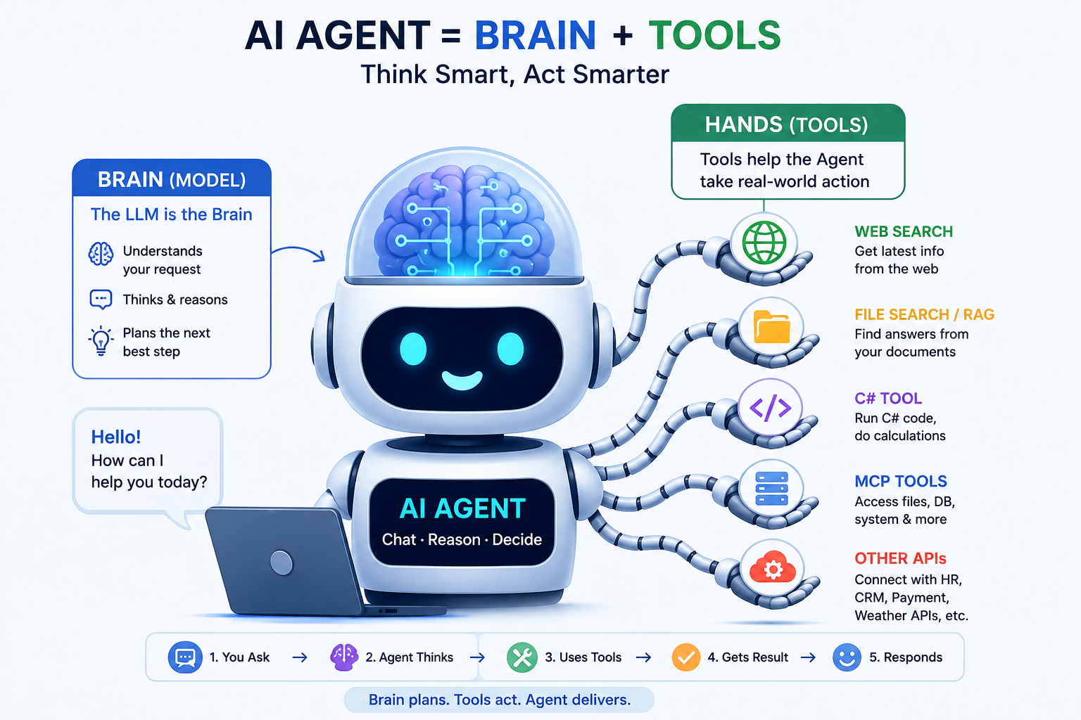
Agent -> Digital Human

Slide 4
How Agent Works
Agent
LLM
Think
Plan
TOOL
C# function
Get Emp Details
Memory
Get Emp Leave count
MCP Tool
File access
DB Access

Slide 5
Reasoning Models
AI Agent use Reasoning Models
GPT‑4 (full versions)
Claude 3 Sonnet
Gemini Advanced / Ultra
LLaMA‑3‑70B

Slide 6
Reasoning Models
“Can you write email for my order details and please share last 5 month orders.
Reasoning Model will work like below
First, it will read complete sentence, Will Create Plan like below
Fetch Order details
Fetch Last 5 month Order details
Combine Both into one.
Draft User professional Email
Send Email.
So here we can see Reasoning Models suitable when we need to work on Complex work.

Slide 7
Tool Calling – Agent BackBone
This feature supported by all Models like Claude, OpenAI, google Gemini.
We need to Pass List of tool available during LLM calls
Based on input LLM checks list of tool present and create Plan and Goal
Based on Input LLM respond with sequence of action to Call
C# application parse this code and execute C# code step by step

Slide 8
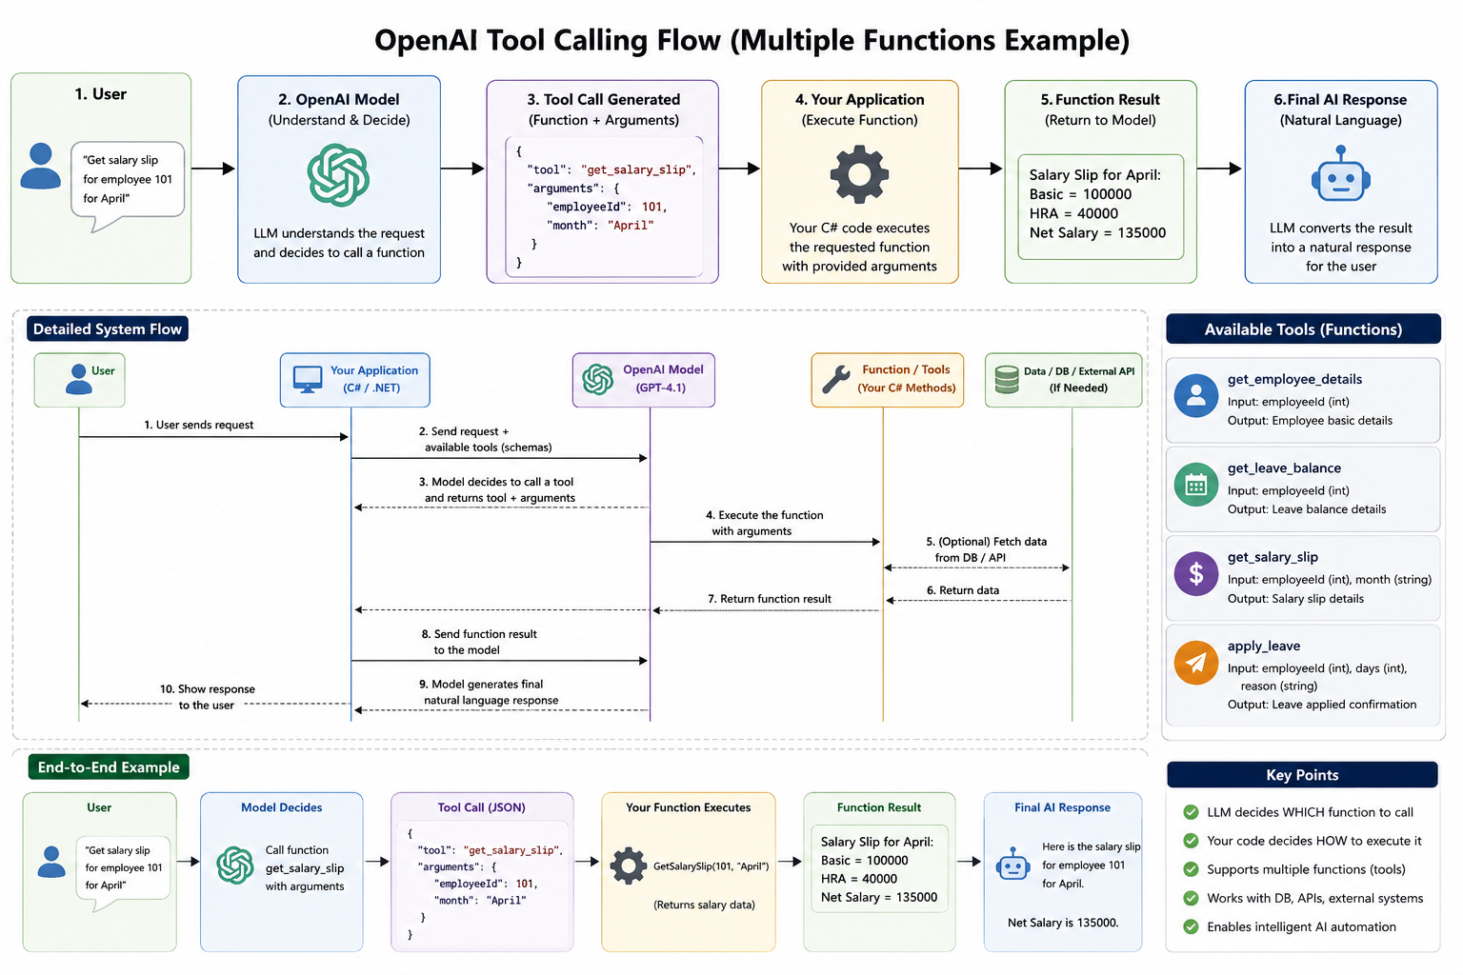
Flow for Tool calling

Slide 9
Agent Loop

